Slide 1
Embodied AI Week 18
- Shaoqin Li

Slide 2
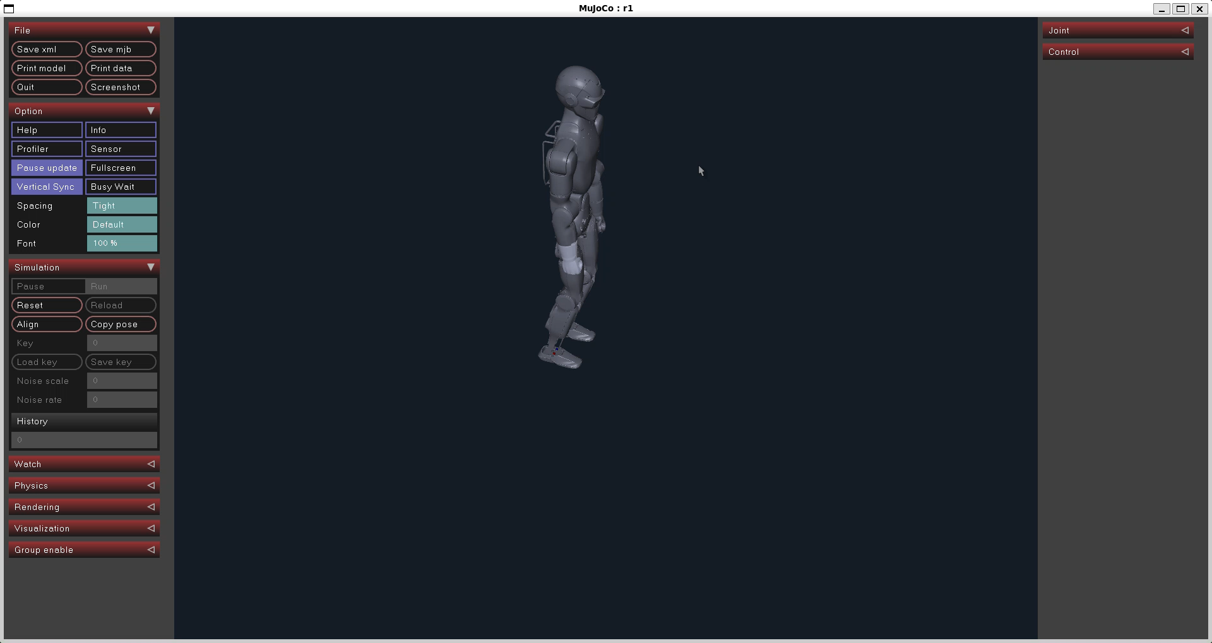
Fixing r1_stand.py
From my presentation last week, we can see r1 was able to land on ground for a few seconds then starts to fall
My work was to troubleshoot what went wrong
But first, check out the result

Slide 3
What changes have I done
Change starting posture when r1 spawns in the simulator: originally, r1 is spawned with 0 rad joint angles, meaning all its joints are straighten, clearly not a good posture to keep your balance. Gravity will start pulling r1 down onto the floor before the controller could put forces to the joints
Increase gain of joints and add damping to each actuator, these gives joint more torque and resistance to counter gravity

Slide 4
Creating another environment
As I mentioned in the last couple presentations. In order to deploy policy to the real humanoid in a safe way, we need to have sim to sim to test it.
So Before proceed to anything heavy, I am setting up another simulator.

Slide 5
Unitree_Mujoco
Based on my spec, Unitree_Mujoco seems to be a great choice (m only choice, actually), the others are too heavy
Q: How is it sifferent from the mujoco I used earlier?
A: It adds the DDS communication layer which is what we do on the humanoid deployment

Slide 6
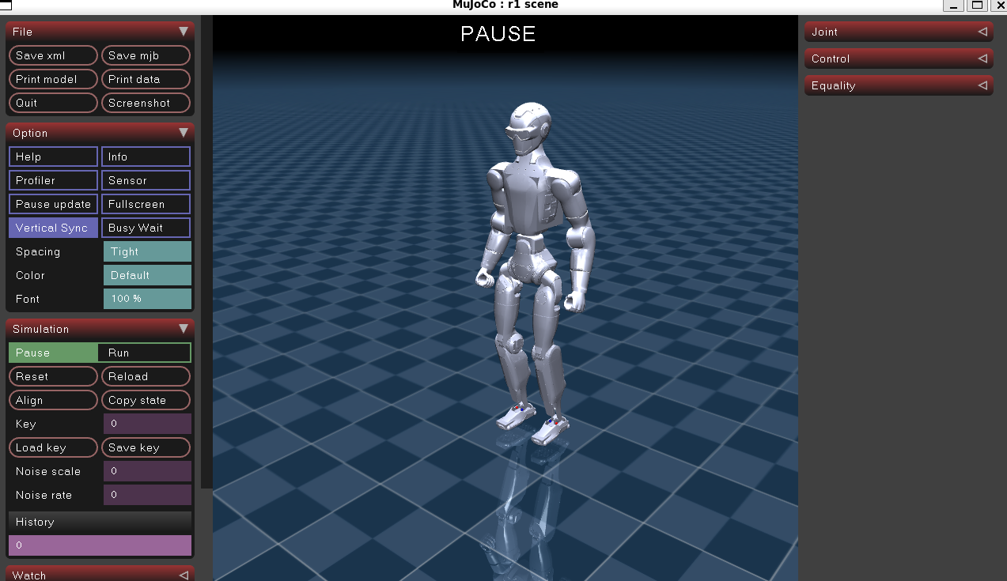
Loading r1

